Slide 1
4-4 Material Design Images & Animation
Anurag Alladi
Karthik Reddy Muthylala
Surya Raj
Telio de Castro
Sonam Gadekari

Slide 2
What is Bootstrap Material Design?
Bootstrap is the most popular HTML, CSS, and JavaScript framework for developing responsive, mobile-first websites.
Material design for Bootstrap is an open source toolkit based on Bootstrap for developing apps.
Bootstrap CDN
When you only need to include Bootstrap's compiled CSS or JS, you can use BootstrapCDN.
https://sonamgadkari.github.io/Project/
Karthik

Slide 3
Advantages of material design
Branding
Material design uses flat and light objects. It requires just two to three colors to brand the entire APP. material design is easy to brand the APPs you develop
User Engagement
In the era of Internet it is very important to engage users. You have to constantly communicate with users through your APP. User Engagement is one of the key factors to success.
Karthik

Slide 4
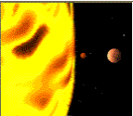
CSS Styling Images
Animated Buttons: Press effect, Grow effect, spread effect
Infinite scrolling background
Coordinates
〈map name="planetmap"〉 〈area shape="rect" coords="0,0,82,126" alt="Sun" href="sun.htm"〉 〈area shape="circle" coords="90,58,3" alt="Mercury" href="mercur.htm"〉 〈area shape="circle" coords="124,58,8" alt="Venus" href="venus.htm"〉 〈/map〉
Karthik

Slide 5
General CSS Design Tips
Be consistent in your design and make sure it’s user friendly
Use !important when you want to force a style without it being overwritten.
Use shorthand if you want to save space in your code
Surya

Slide 6
CSS Animations
An animation is a visualization of change
An animation lets an element gradually change from one style to another.
To use CSS animation, you must first specify some keyframes for the animation.
Keyframes hold what styles the element will have at certain times.
Surya

Slide 7
CSS Images
Transparent Image(using Opacity)​
Image filters(using GrayScale)​
Image Hover​
Image Hover Overlay

Slide 8
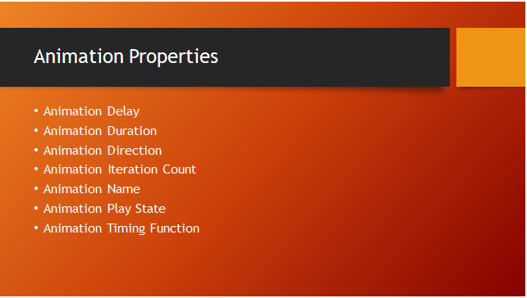

Slide 9
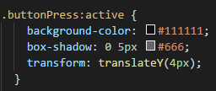
Button Press Animation
Telio

Slide 10

Button Grow Animation
Telio

Slide 11

Button Spread Animation
Telio

Slide 12
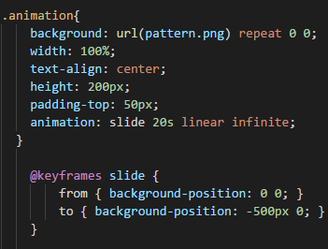
Scrolling Background
Telio

Slide 13
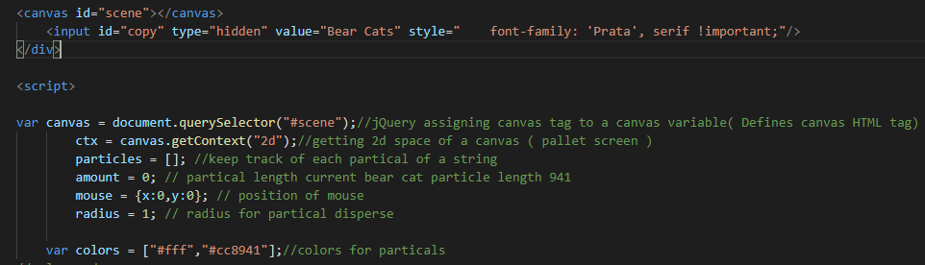
Creating and assigning canvas
Anurag

Slide 14
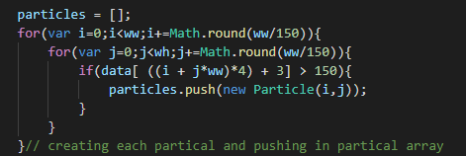
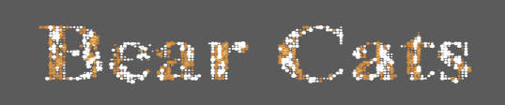
Text division into particles
Anurag

Slide 15
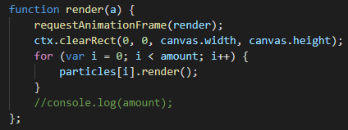
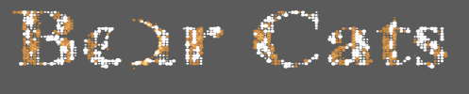
Particle rendering animation
Anurag

Slide 16
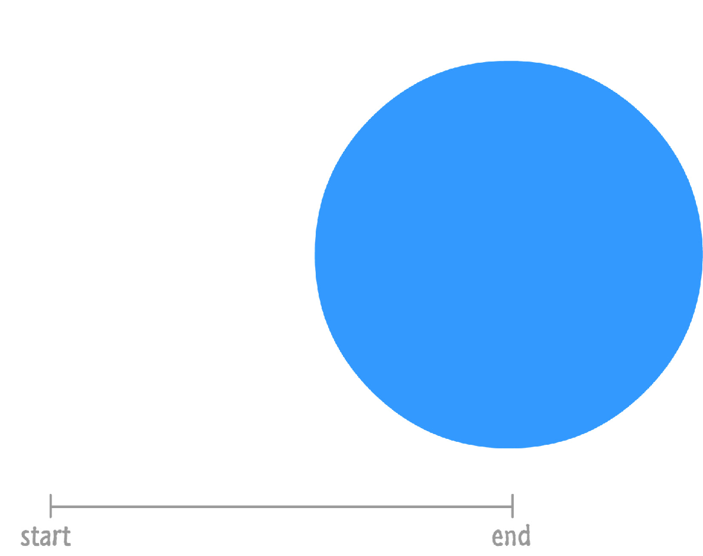
Animation: The Start and End States
Create some reference points so that we can compare what has changed. Let's call these reference points the start state and the end state. In this Our blue circle is just sitting around and probably up to no good.
Sonam

Slide 17
Animation properties
@keyframes drive
animation-name: drive;
animation-duration: 3s;
animation-fill-mode: forwards;
animation-delay: 2s;
https://sonamgadkari.github.io/Project/
Sonam

Slide 18
BootStrap Format
<div class="container-fluid"> <h1>my first bootstrap page</h1> <p>this is some text.</p>
<div class="row"> <div class="col-*-*"></div> <div class="col-*-*"></div> </div> <div class="row"> <div class="col-*-*"></div> <div class="col-*-*"></div> <div class="col-*-*"></div> </div> </div>
md,lg,sm
Sonam

Slide 19
BootStrap Carousel
Slideshow for cycling through a series of content
https://sonamgadkari.github.io/Project/
Sonam

Slide 20
References
https://mdbootstrap.com/md-bootstrap-cdn/
https://www.hongkiat.com/blog/20-useful-css-tips-for-beginners/
https://www.w3schools.com/css/

